Slide 1

Properties of antimatter studied at the CERN Antiproton Decelerator
Marco G. Giammarchi
Istituto Nazionale Fisica Nucleare - Milano
Outline of talk:
Brief history of Antimatter
Why study antimatter
Status of tests with anti H
Outlook

Slide 2

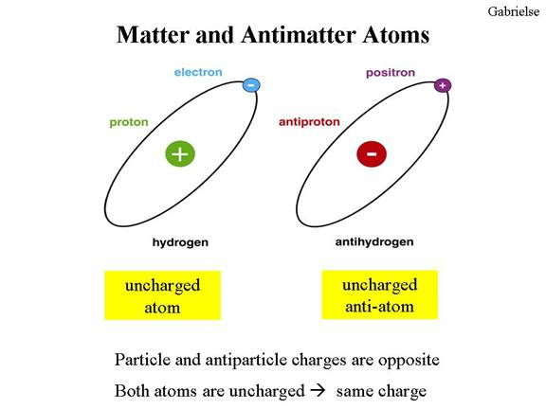
Angels & Demons?
How to have antimatter ?
Change all discrete internal quantum numbers (charge…) of elementary constituents
Why antimatter ?

Slide 3
Particles and Antiparticles: the “birth” of Particle Physics
1928: Dirac Equations, putting togetheter Special Relativity and Quantum Mechanics. A relativistically invariant equation for massive spin ½ particles.
Four solutions in the rest frame
E>0, s=+1/2
E>0, s=-1/2
E<0, s= +1/2
E<0, s= -1/2
Reinterpretation of negative-energy states as the electron’s antiparticle:
Electron, s=+1/2
Electron, s=-1/2
The positron, a particle which is identical to the electron e⁻ except for having positive charge: e⁺. The first prediction of the relativistic quantum theory.
Positron, s=1/2
Positron, s=-1/2

Slide 4
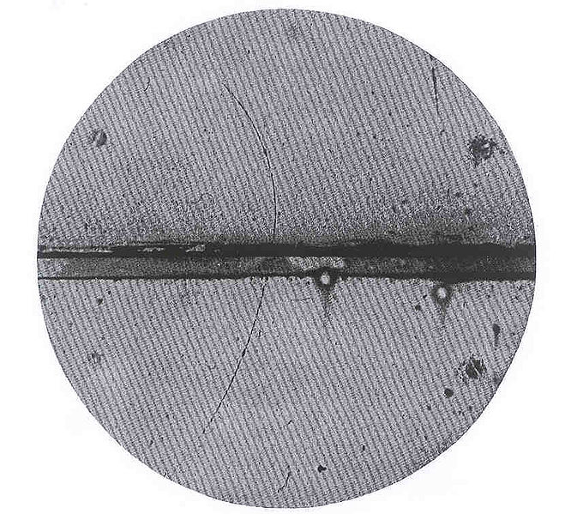
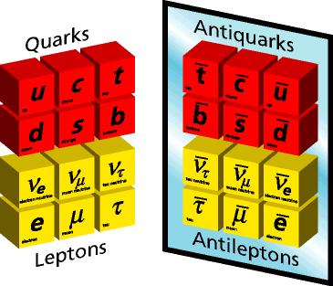
The first antimatter particle to be discovered: the positron (antielectron)
Positrons discovered in cosmic rays interaction in cloud chamber (Anderson, 1932)
The existence of antiparticles is a very general (albeit not universal) property of elementary particles.
Antiparticle: same mass of the particle but opposite charge (and magnetic moment)
All elementary constituents have an antiparticle !

Slide 5
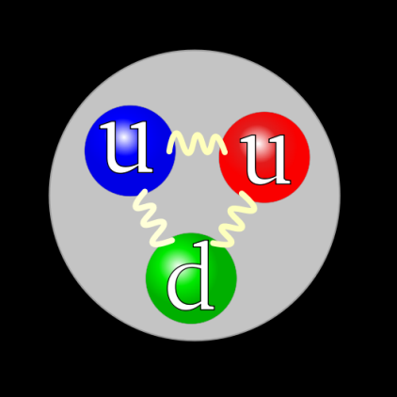
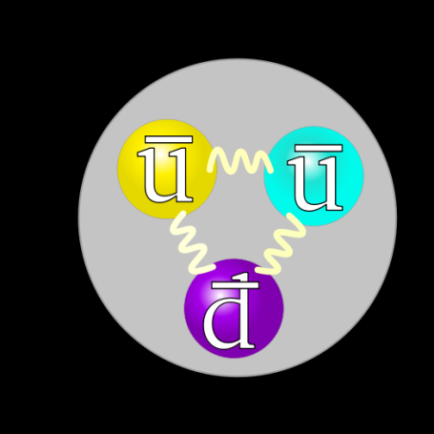
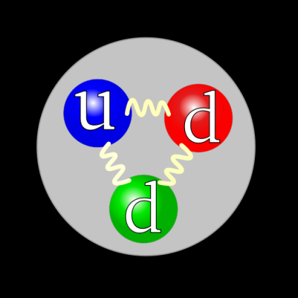

Recipe to build antimatter:
Ideally divide matter in (elementary) constituents
Take the anti… of every elementary particle
Put the thing back togheter
PROTON: QUARKS
ANTIPROTON: ANTIQUARKS
The antiproton :
The anti-neutron:
NEUTRON: QUARKS
ANTINEUTRON: : ANTIQUARKS

Slide 6
History of Antimatter in a slide
1928: relativistic equation of the ½ spin electron (Dirac)
1929: electron sea and hole theory (Dirac)
1931: prediction of antimatter (Dirac, Oppenheimer, Weyl)
1932: discovery of positron in cosmic rays (Anderson)
1933: discovery of e-/e+ creation and annihilation (Blackett, Occhialini)
1937: symmetric theory of electrons and positrons
1955: antiproton discovery (Segre’, Chamberlain, Wiegand)
1956: antineutron discovery (Cork, Lambertson, Piccioni, Wenzel)
1996: creation of high-energy antihydrogen (CERN, Fermilab)
2002: creation of 10 K antihydrogen (Athena, Atrap)
2011: antihydrogen confinement (Alpha)
Future: study of Antimatter properties !!

Slide 7
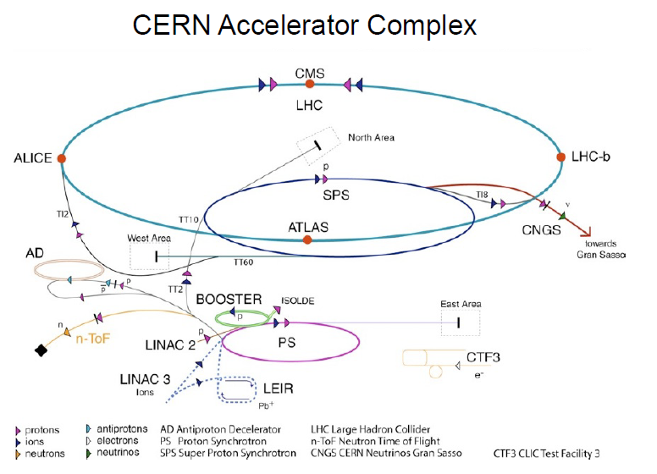
Antiprotons: how to produce the essential ingredient

Slide 8
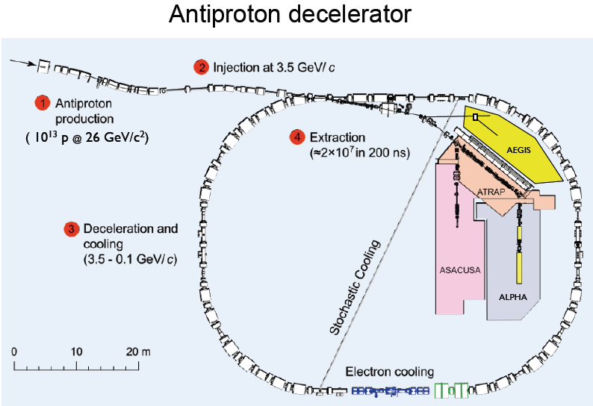

Slide 9
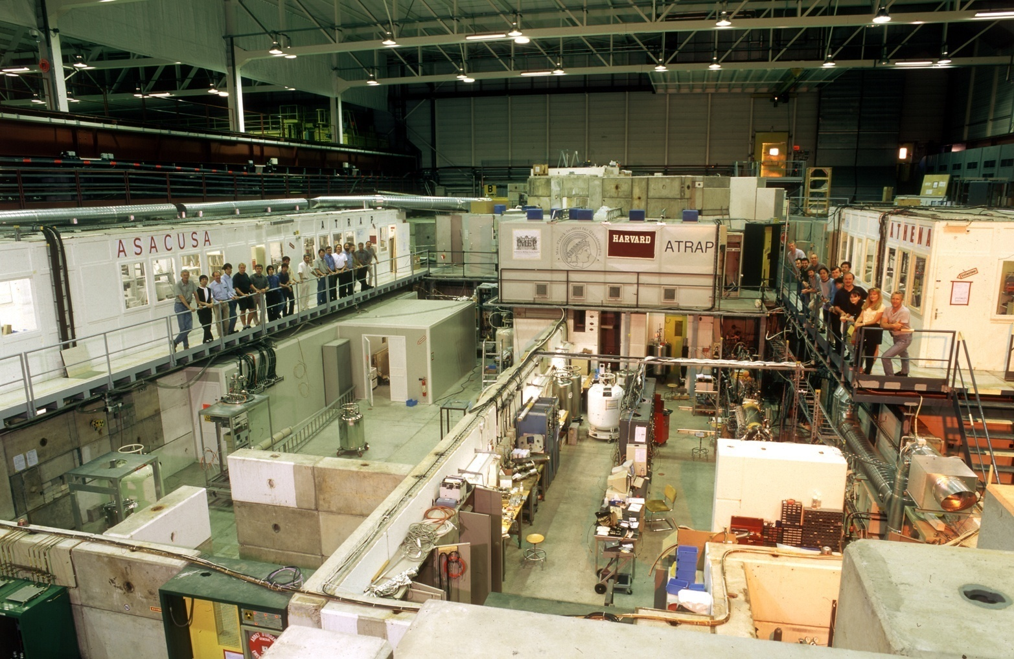
AD (Antiproton Decelerator) at CERN
3 x 10⁷ antiprotons / 100 sec 6 MeV (trap 10⁴ pbar / 100 sec)

Slide 10
Physics with Antimatter is at the very foundation of Modern Physics:
CPT Physics
WEP (Weak Equivalence Principle)
CPT Theorem
Charge conjugation (C) : reversing electric charge and all internal quantum numbers
Parity (P): space inversion; reversal of space coordinates
Time reversal (T): replacing t by –t. Reverses time derivatives
Any local, Lorentz invariant Lagrangian is CPT symmetric (Lüders, Pauli 1959). CPT is proven in axiomatic Quantum Field Theory.
Consequences:
Particles and antiparticles have identical masses and lifetimes
All internal quantum numbers of antiparticles are opposite to those of particles
CPT conserved to the best of our knowledge. So why look for violations?
A test of CPT is not only a test of a discrete symmetry. It is a test of the validity of Quantum Field Theory
CPT could break down in a Quantum Theory of Gravity

Slide 11
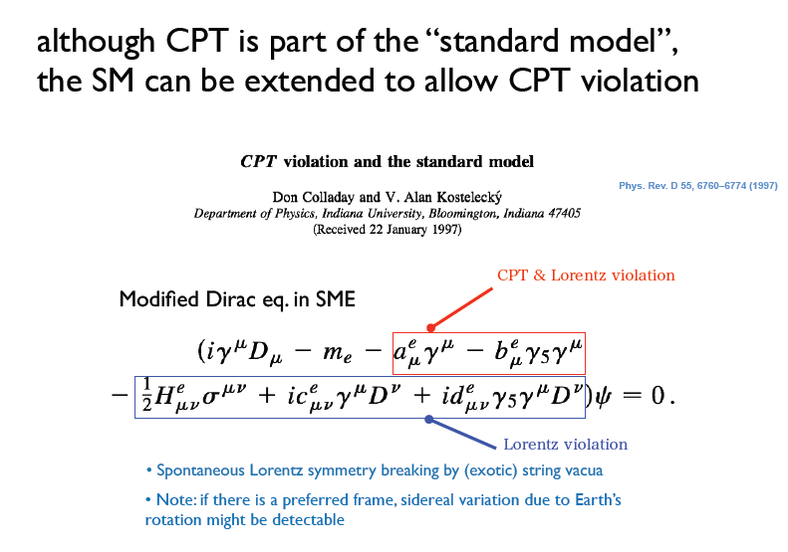

Slide 12
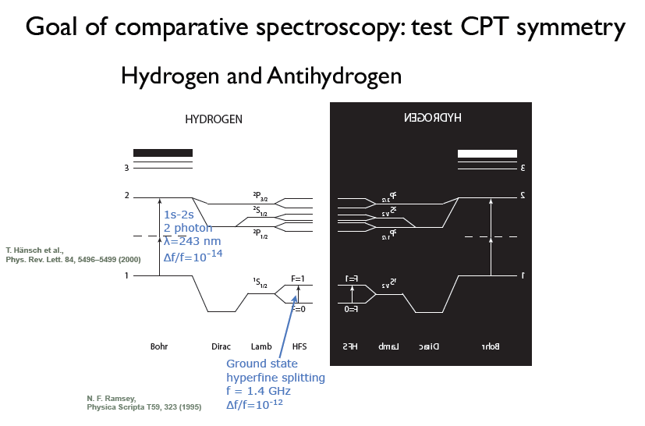

Slide 13
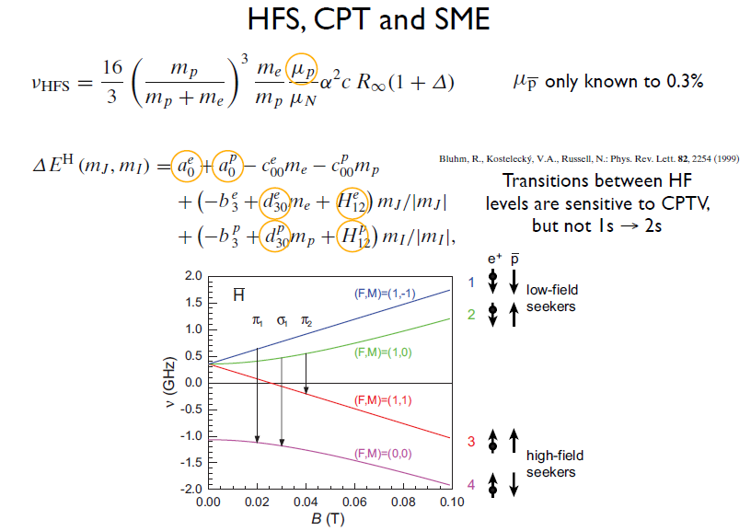

Slide 14
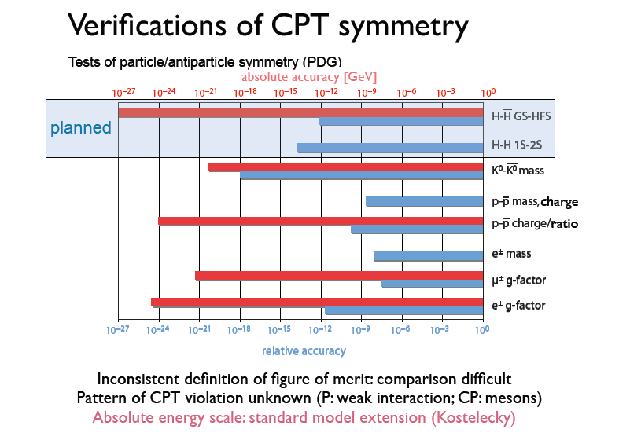

Slide 15
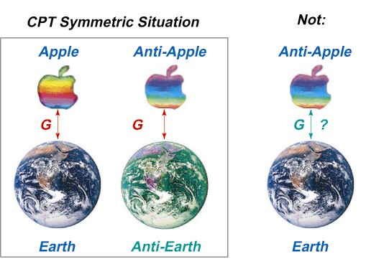
WEP: Weak Equivalence Principle
The trajectory of a falling test body depends only on its initial position and velocity and is independent of its composition (a form of WEP)
All bodies at the same spacetime point in a given gravitational field will undergo the same acceleration (another form of WEP)
Direct Methods: measurement of gravitational acceleration of H and Hbar in the Earth gravitational field
High-precision spectroscopy: H and Hbar are test clocks (this is also CPT test)

Slide 16
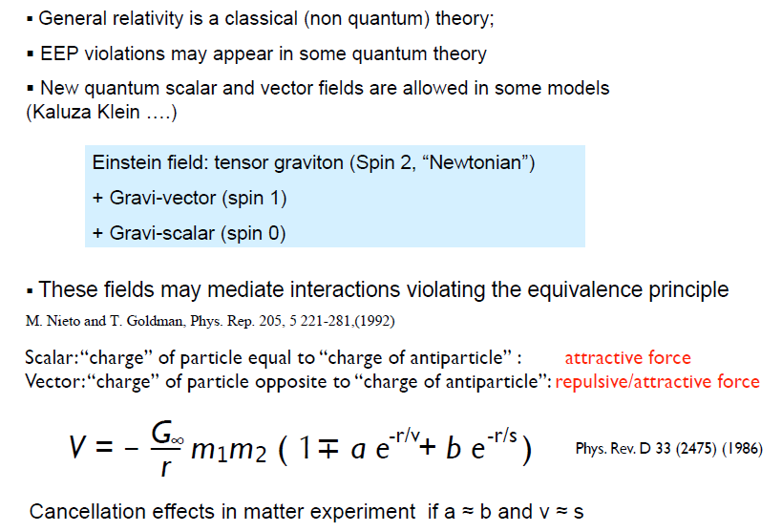

Slide 17

Gravitational Physics: Weak Equivalence Principle
No direct measurements on gravity effects on antimatter
“Low” precision measurement (1%) will be the first one
10⁻¹⁸
WEP tests on matter system
10⁻¹⁶
10⁻¹⁴
10⁻¹²
10⁻¹⁰
10⁻⁸
10⁻⁶
10⁻⁴
10⁻²
1700
1800
1900
2000
Can be done with a beam of Antiatoms flying to a detector!
AEGIS first phase
L
H
g

Slide 18
Antimatter investigations!
ANTIHYDROGEN PROGRAM @ CERN
PHASE I: Production of “cold” antihydrogen atoms (2000-2004)
ATHENA (ApparaTus for High precision Experiment on Neutral
Antimatter,or shortly AnTiHydrogEN Apparatus)
ATRAP (Antihydrogen TRAP)
PHASE II: Cold-Antihydrogen Physics (2006-?)
ATRAP
ALPHA (Antihydrogen Laser PHysics Apparatus)
ASACUSA
AEGIS (Antimatter Experiment: Gravity, Interferometry, Spectroscopy)

Slide 19
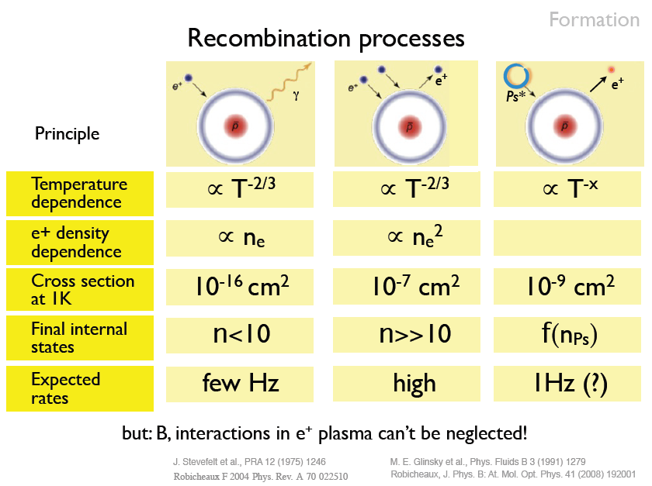

Slide 20
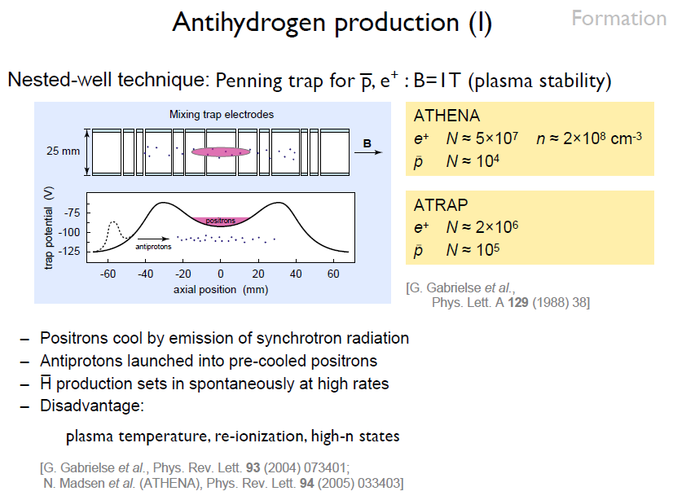

Slide 21
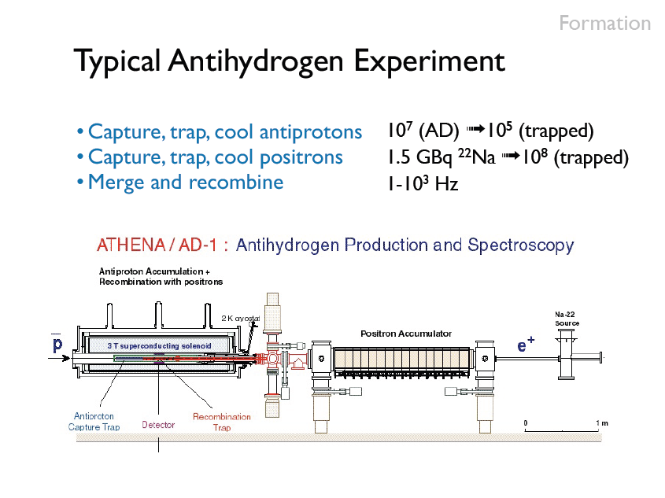

Slide 22
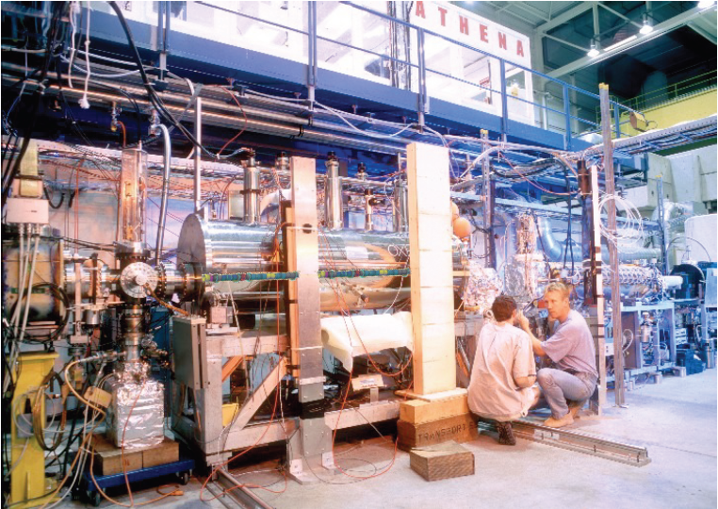

Slide 23
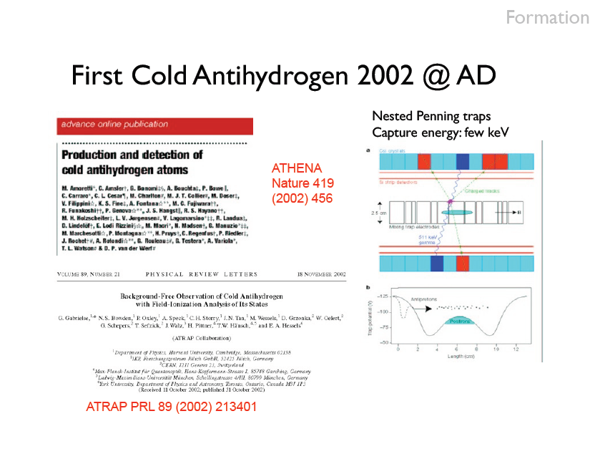

Slide 24
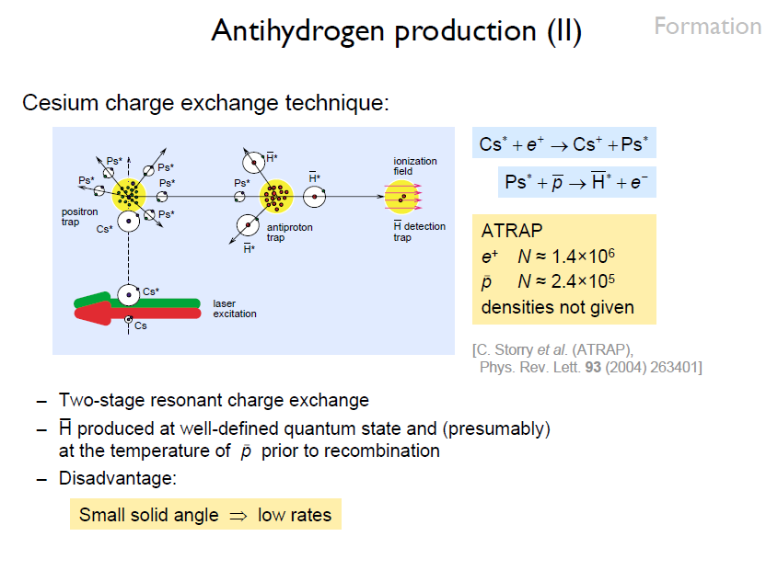

Slide 25
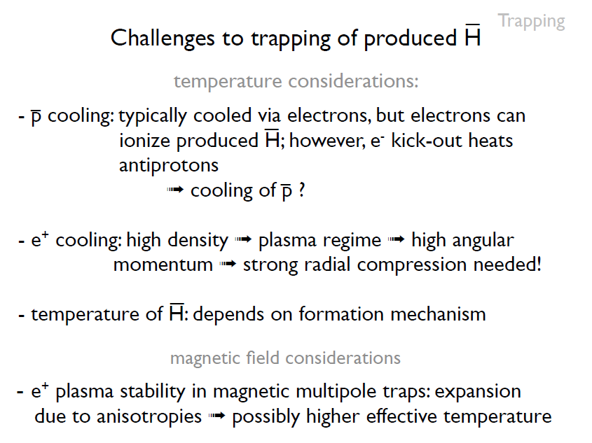

Slide 26
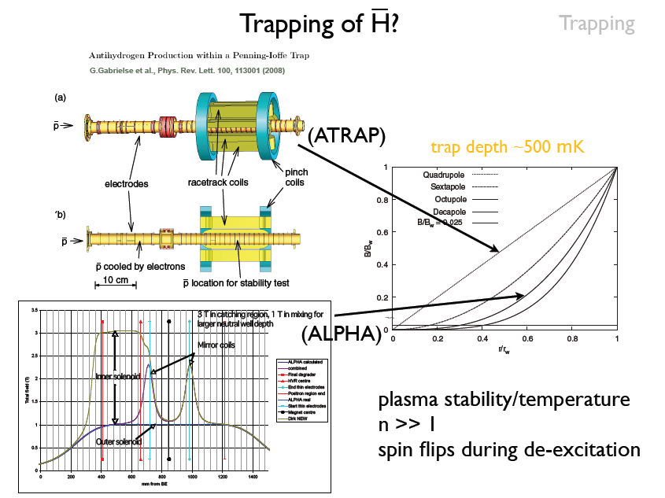

Slide 27
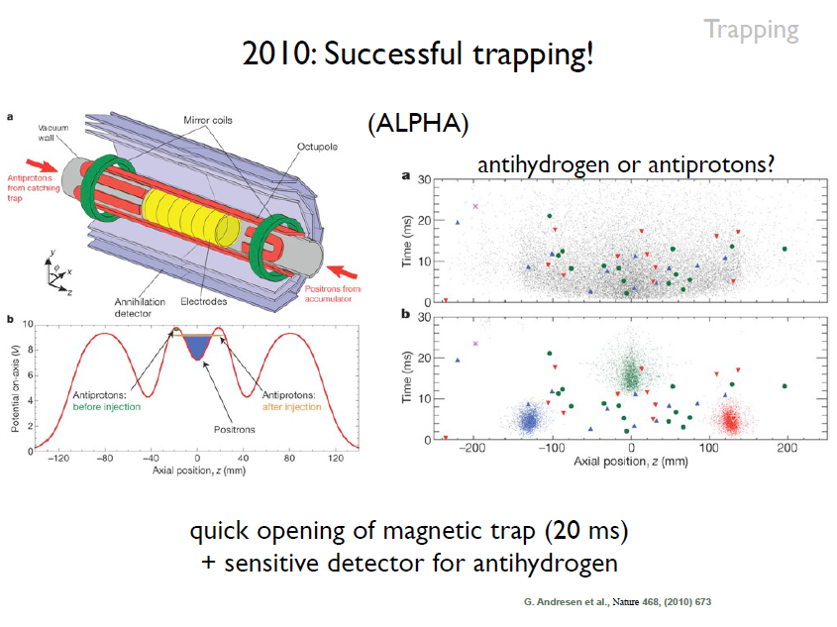

Slide 28
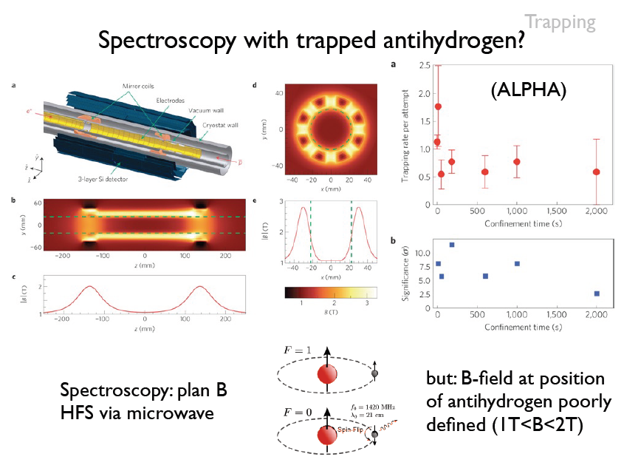

Slide 29
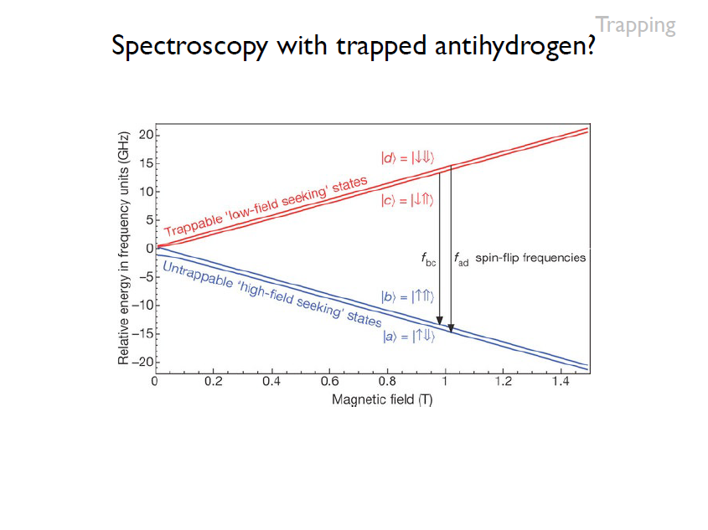

Slide 30
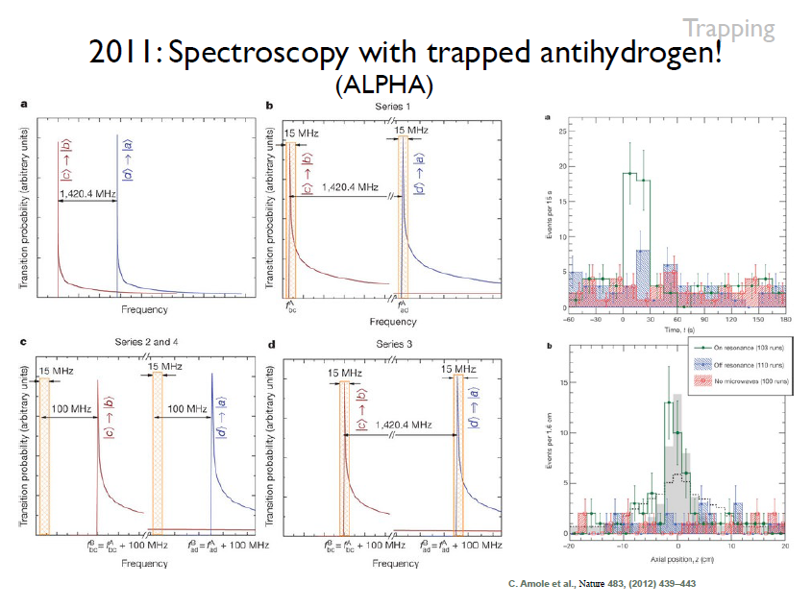

Slide 31
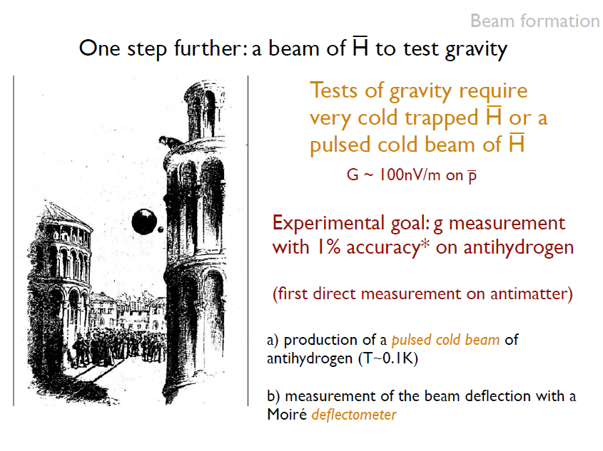

Slide 32
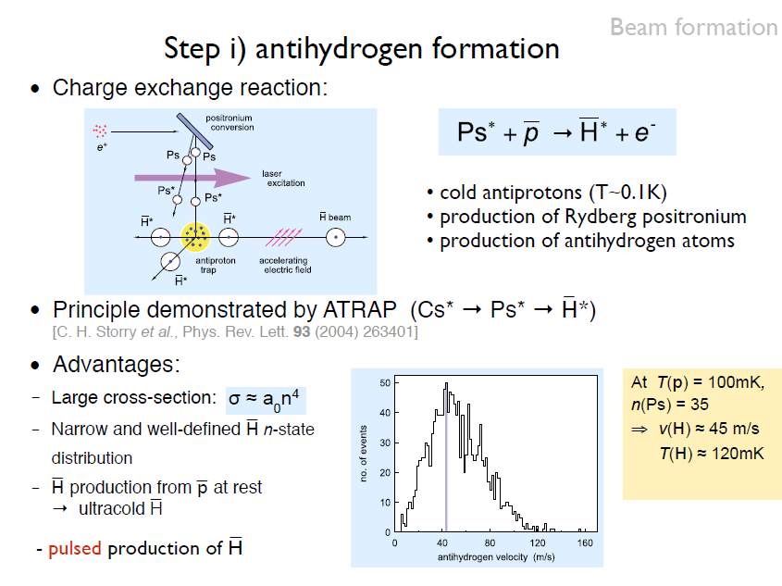

Slide 33
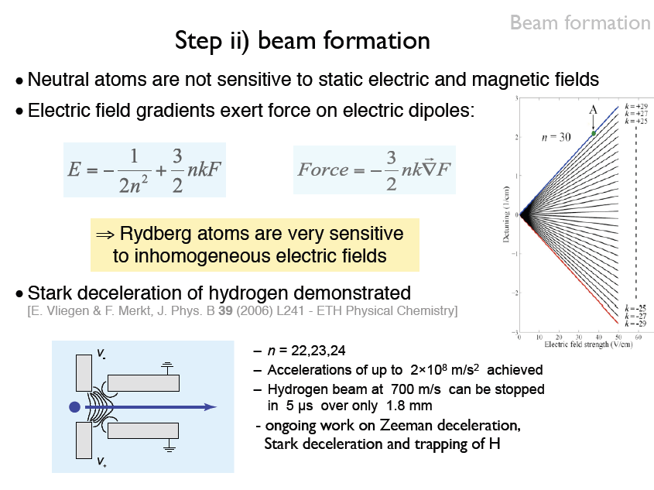

Slide 34
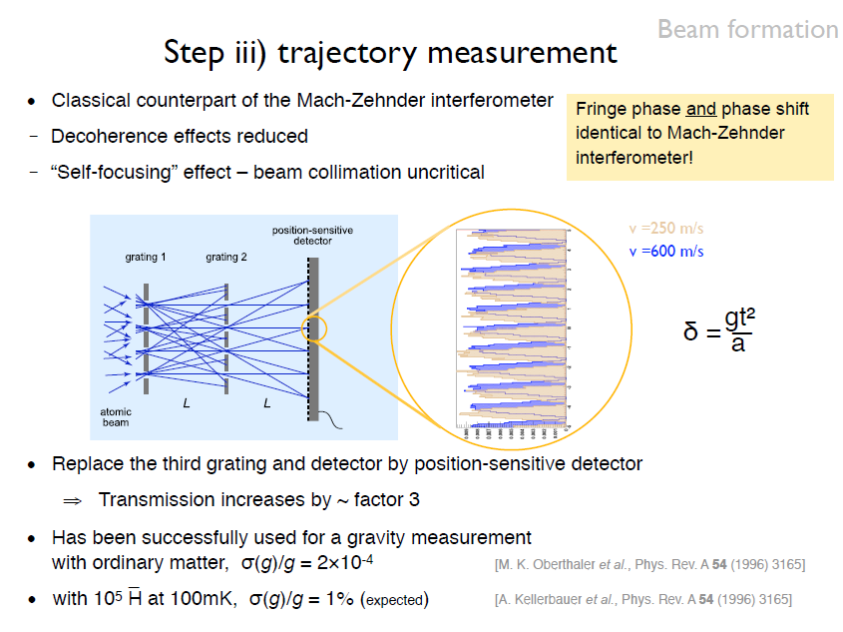

Slide 35
Antihydrogen fall and detection
AEgIS realistic numbers:
- horizontal flight path L ~ 1 m
- horizontal velocity vz ~ 500 m/s
vertical deflection ~ 20 μm
BUT: - antihydrogen has a radial velocity (related to the temperature)
- any anti-atom falls by 20 μm, but, in addition it can go up or down by few cm
- beam radial size after 1 m flight ~ several cm (poor beam collimation)
DISPLACEMENT DUE TO GRAVITY IS IMPOSSIBLE TO DETECT IN THIS WAY

Slide 36
Let us collimate!
Position sensitive detector
cm
Now displacement easily detectable. At the price of a huge loss in acceptance
Acceptance can be increased by having several holes. In doing so new possible paths show up
L₁
L₂
Let us collimate!
cm
If L₁ = L₂ the new paths add up to the previous information on the 3rd plane

Slide 37
Based on a totally geometric principle, the device is insensitive to a bad collimation of the incoming beam (which however will affect its acceptance)
Moiré Deflectometry is an interferometry technique, in which the object to be tested (either phase object or secular surface) is mounted in the course of a collimated beam followed by a pair of transmission gratings placed at a distance from each other. The resulting fringe pattern, i.e., the moiré deflectogram, is a map of ray deflections corresponding to the optical properties of the inspected object.

Slide 38
The final plane will be made of Silicon Strip detectors with a spatial resolution of about 10-15 μm
De Broglie wavelength of a 500 m/s H atom:
Now, this is NOT a quantum deflectometer, because:
d_{g}
α
L
So, it is a classical device if d_{g}>> 10 μm

Slide 39
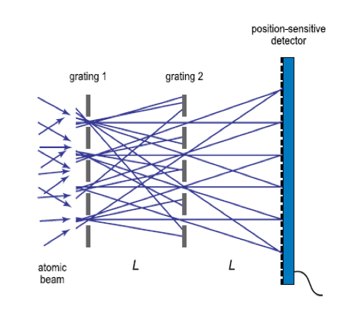
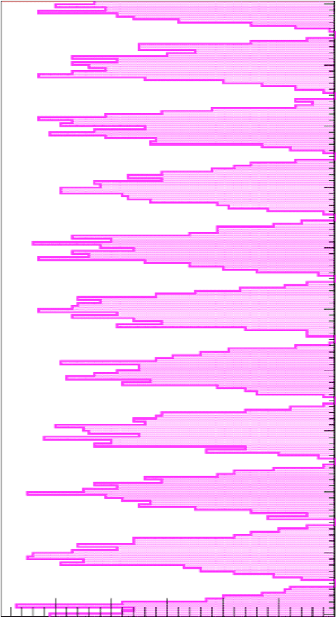
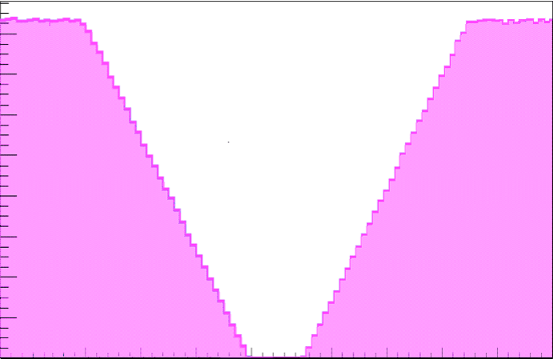
moiré deflectometer
M o i r é deflectometer
X
annihilation hit position on the final detector
(in x/a units)
Suppose:
- L = 40 cm
- grating period a = 80 μm
- grating size = 20 cm (2500 slits)
- no gravity
Z
Grating transparency = 30%
(total transmission 9%)
annihilation hit position on the final detector
(in x/a units, modulo grating period a)
fringes
-5 -4 -3 -2 -1 0 1 2 3 4 5
(x/a)
grating slits shadow
counts (a.u.)
slit
solid
slit
depends on the alignement between the gratings, and on the alignment between them and the center of the antihydrogen cloud. It is indepentend to the radial antihydrogen velocity and profile
]a
Δo (calculated experimentally)
0 0.25 0.5 0.75 1
x/a
counts (a.u.)

Slide 40
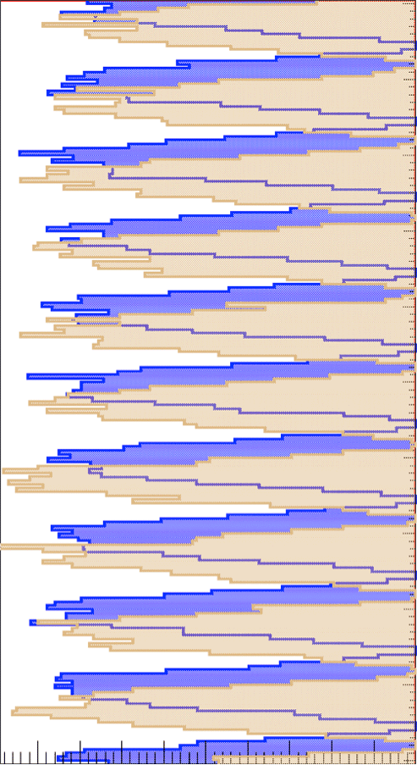
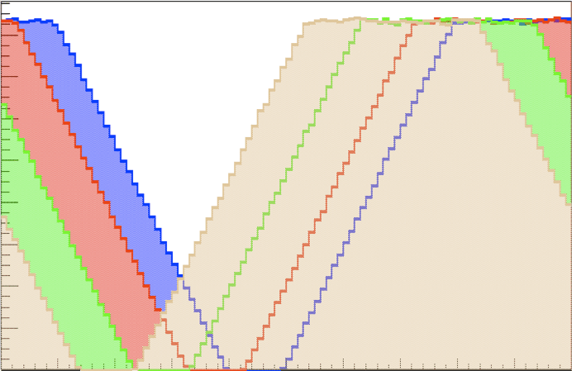
moiré deflectometer
M o i r é deflectometer
X
Suppose:
- L = 40 cm
- grating period a = 80 μm
- grating size = 20 cm (2500 slits)
- gravity
annihilation hit position on the final detector
(in a units)
beam horizontal velocity
Z
Grating transparency = 30%
(total transmission 9%)
vz = 600 m/s
vz = 250 m/s
annihilation hit position on the final detector
(in a units, modulo grating period a)
fringe shift
-5 -4 -3 -2 -1 0 1 2 3 4 5
(x/a)
grating slits shadow
counts (a.u.)
slit
solid
slit
]a
Fringe shift !
0 0.25 0.5 0.75 1
x/a
counts (a.u.)

Slide 41

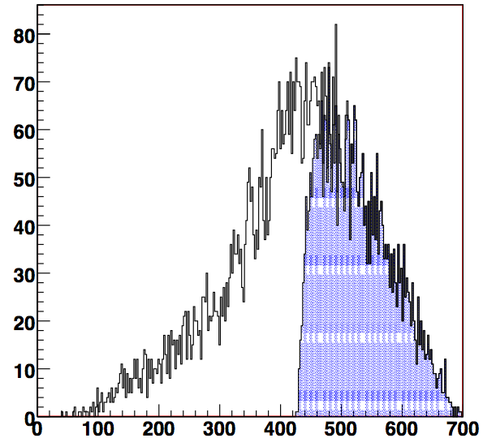

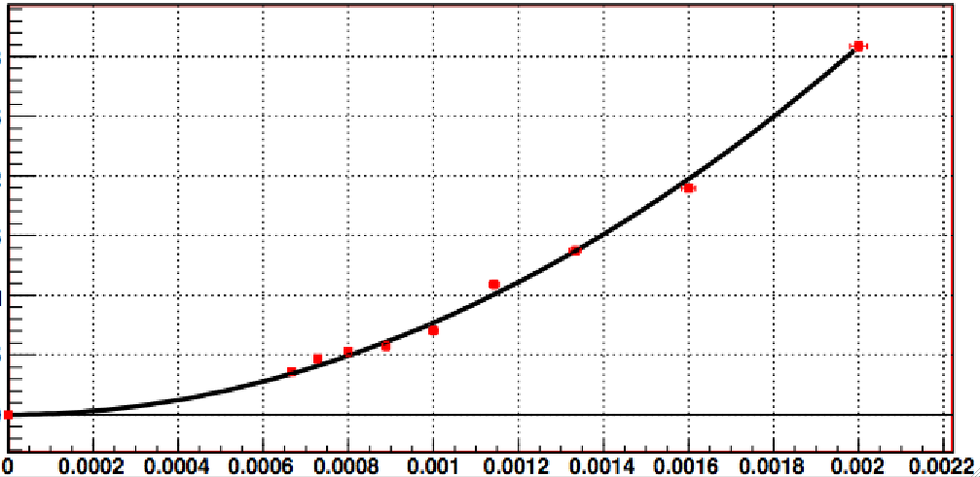
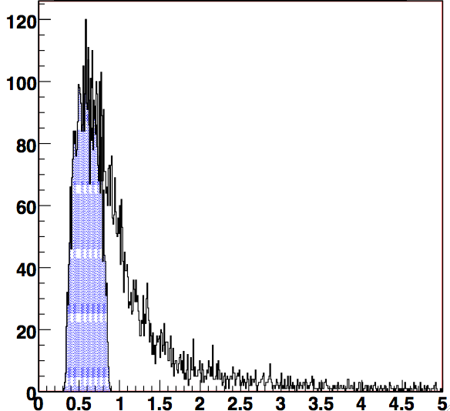
M o i r é deflectometer
Out beam is not monochromatic
(T varies quite a lot)
fringe shift of the shadow image
v
counts (a.u.)
T = time of flight = [tSTARK - tDET] (L~ 1 m, v ~ 500 m/s ➠T ~ 2 ms)
Binning antihydrogens with mean velocity of 600-550-500-450-400-350-300-250-200 m/s,
and plotting δ as a function of
➠
m/s
➠
δ (a.u.)
g comes from the fit
T²
counts (a.u.)
ms²
time of flight T (s)

Slide 42
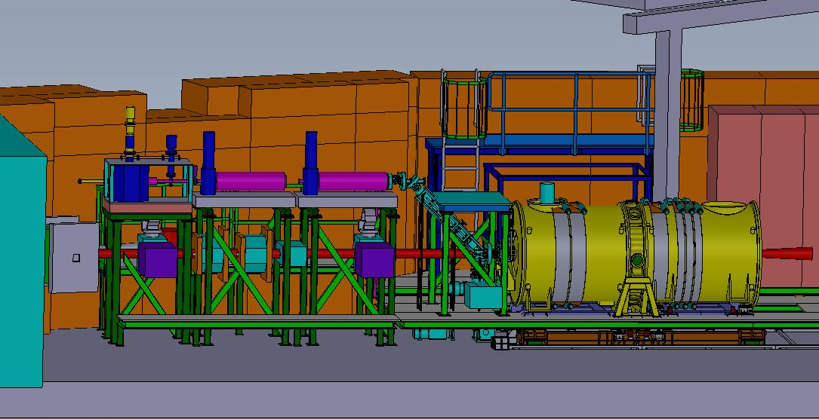
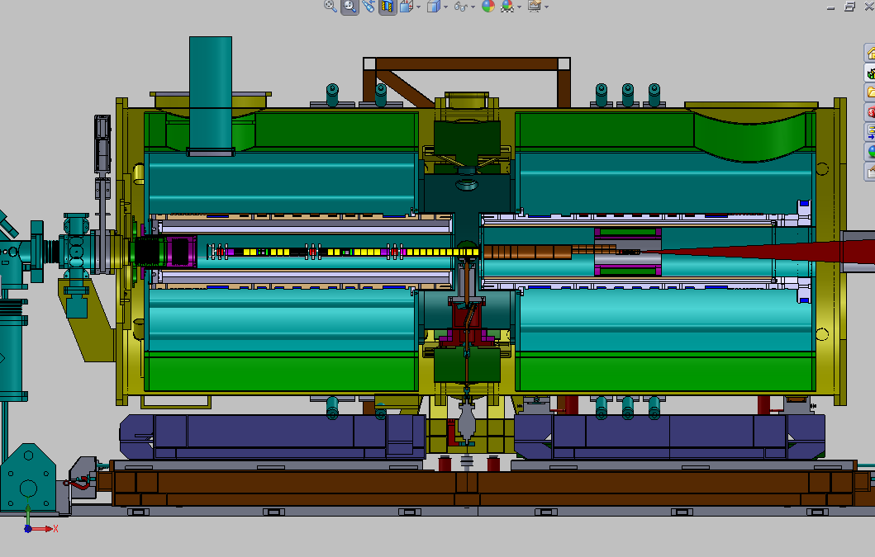
AEGIS: Antimatter Experiment:
Gravity, Interferometry, Spectroscopy
²²Na
e⁺ source
Surko trap & accumulator
p trap
mixing chamber
AD
beam
Moiré deflectometer
Notes:
This is a scheme of Aegis apparatus. The positron source is a twenty-two sodium radioactive isotope, the beta decay emission is moderated and accumulated in a two stages surko trap and accumulator, where a buffer gas at low pressure aid the energy degrading of the fast beta emitted positrons. Meanwhile the antiprotons from antiproton decelerator are slowed and stored in the first section of aegis cryostat, in a five tesla magnetic field. About one every few hundred seconds the positron bunch, of about ten to eight particles, is guided inside aegis cryostat to make antihydrogen with about ten to five antiprotons. The antiprotons are driven to the second stage of aegis cryostat, at one tesla, and cooled up to 0.1 kelvin. The positron bunch is shifted off axis, of a small quantity using plasma manipulation techniques and eventually trapped to compress it. Many of this stages are critical and not yet realized by other experiments, in particular the cooling of antiprotons and the off axis guiding and trapping of the positron plasma.

Slide 43
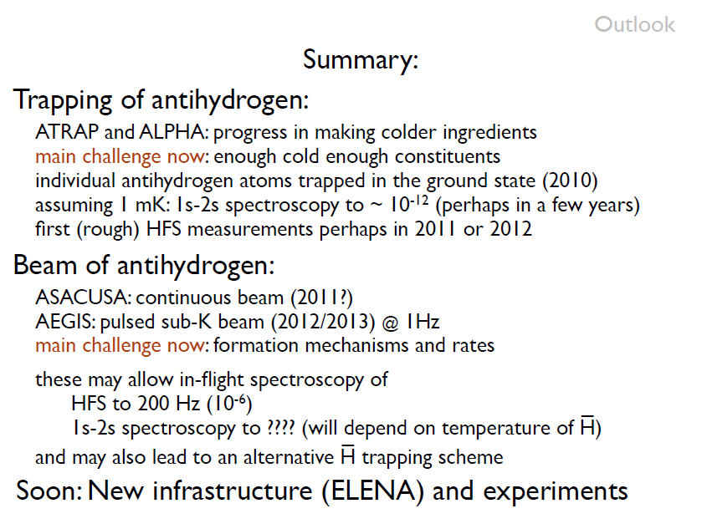

Slide 45
Backup slides

Slide 46
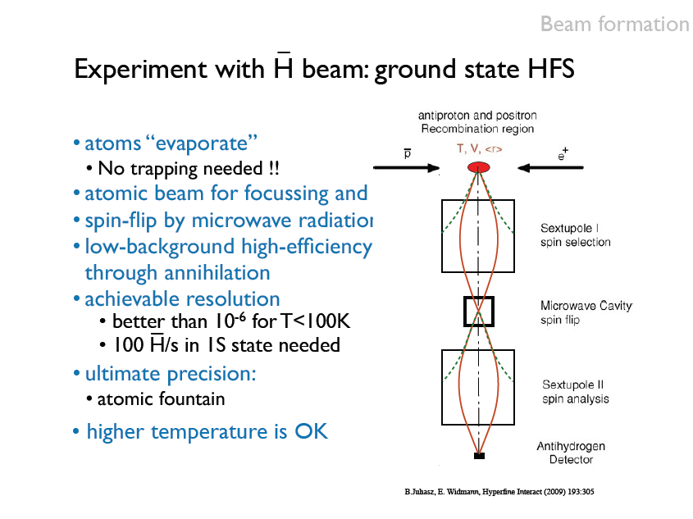

Slide 47
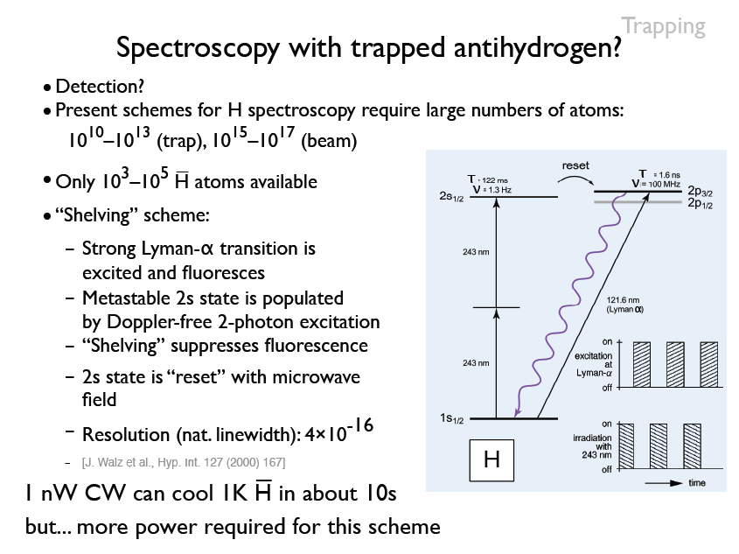

Slide 48
AEGIS strategy to produce Antihydrogen:
1. COLD ANTIHYDROGEN PRODUCTION
Nested Penning Trap (warm antihydrogen / highly excited antiatoms)
Charge Exchange with Rydberg Positronium
Slow antiprotons (cold antihydrogen)
Rydberg Positronium
Positronium formation
Positronium excitation
Avoid the problem of a particle trap able to simultaneously confine charged particles (Penning trap) and Antihydrogen (by radial B gradients).
Have a charged particle trap only
g measurement
Form a neutral (antihydrogen) beam
Confine only neutrals (future)
(CPT physics)

Slide 49
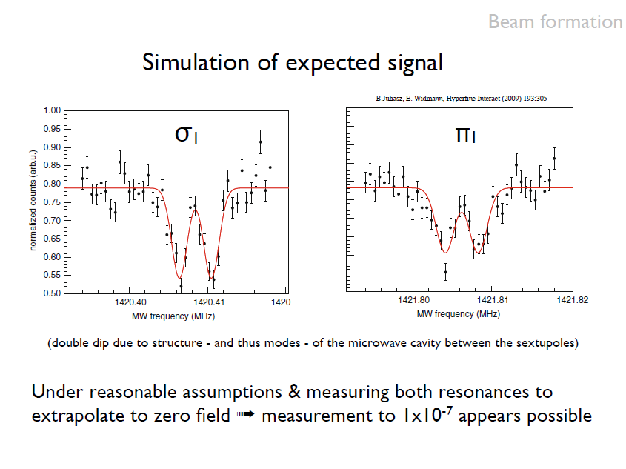

Slide 50



















AEGIS Collaboration
CERN, Geneva, Switzerland M. Doser, D. Perini, T. Niinikoski, A. Dudarev, T. W. Eisel, R. Van Weelderen, F. Haug, L.. Dufay-Chanat, J. L.. Servai
LAPP, Annecy, France. P. Nédélec, D. Sillou
Queen’s U Belfast, UK G. Gribakin, H. R. J. Walters
INFN Firenze, Italy G. Ferrari, M. Prevedelli, G. M. Tino
INFN Genova, University of Genova, Italy C. Carraro, V. Lagomarsino, G. Manuzio, G. Testera, S. Zavatarelli
INFN Milano, University of Milano, Italy I. Boscolo, F. Castelli, S. Cialdi, M. G. Giammarchi, D. Trezzi, A. Vairo, F. Villa
INFN Padova/Trento, Univ. Padova, Univ. Trento, Italy R. S. Brusa, D. Fabris, M. Lunardon, S. Mariazzi, S. Moretto, G. Nebbia, S. Pesente, G. Viesti
INFN Pavia – Italy University of Brescia, University of PaviaG. Bonomi, A. Fontana, A. Rotondi, A. Zenoni
MPI- K, Heidelberg, Germany C. Canali, R. Heyne, A. Kellerbauer, C. Morhard, U. Warring
Kirchhoff Institute of Physics U of Heidelberg, Germany M. K. Oberthaler
INFN Milano, Politecnico di Milano, Italy G. Consolati, A. Dupasquier, R. Ferragut, F. Quasso
INR, Moscow, Russia A. S. Belov, S. N. Gninenko, V. A. Matveev, A. V. Turbabin
ITHEP, Moscow, RussiaV. M. Byakov, S. V. Stepanov, D. S. Zvezhinskij
New York University, USA H. H. Stroke
Laboratoire Aimé Cotton, Orsay, FranceL. Cabaret, D. Comparat
University of Oslo, Norway O. Rohne, S. Stapnes
CEA Saclay, France M. Chappellier, M. de Combarieu, P. Forget, P. Pari
INRNE, Sofia, Bulgaria N. Djourelov
Czech Technical University, Prague, Czech Republic V. Petráček, D. Krasnický
ETH Zurich, Switzerland S. D. Hogan, F. Merkt
Institute for Nuclear Problems of the Belarus StateUniversity, Belarus G. Drobychev
Qatar University, Qatar I. Y. Al-Qaradawi

Slide 51
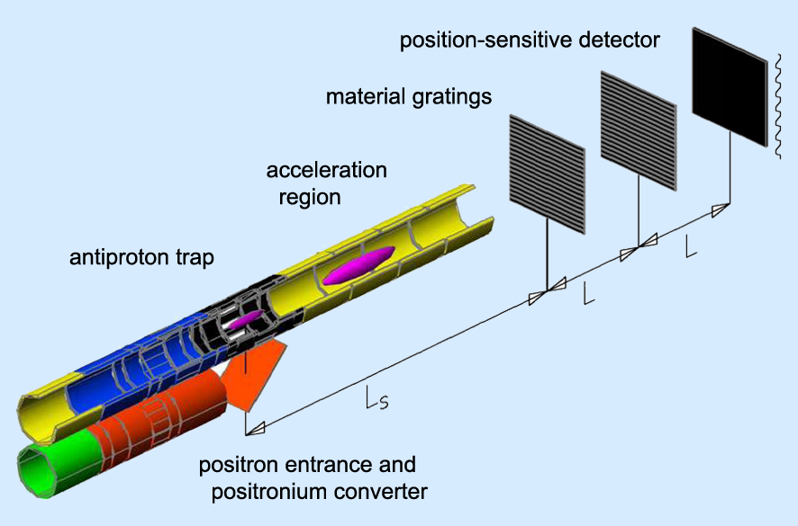
A E g I S in short
Acceleration of antihydrogen.
Formation of antihydrogen atoms
The antihydrogen beams will fly (with v~400 m/sec) through a Moire’ deflectometer, the classical counterpart of a matter wave interferometer
Antiprotons
The vertical displacement (gravity fall) will be measured on the last (sensitive) plane of the deflectometer
Positrons
Such measurement would represent the first direct determination of the gravitational effect on antimatter

Slide 52
AEGIS experimental strategy
Moire’ deflectometer and detector
1) Produce ultracold antiprotons (100 mK)
2) Accumulate e+
3) Form Ps by interaction of e+ with porous target
4) Laser excite Ps to get Rydberg Ps
5) Form Rydberg cold (100 mK) antihydrogen by
6) Form a beam using an inhomogeneous electric field to accelerate the Rydberg antihydrogen
7) The beam flies toward the deflectometer which introduces a spatial modulation in the distribution of the Hbar arriving on the detector
8) Extract g from this modulated distribution
Cold antiprotons
Porous target
e+

Slide 53
Ultracold Antiprotons
The CERN AD (Antiproton Decelerator) delivers 3 x 10⁷ antiprotons / 80 sec
Antiprotons
Production GeV
Deceleration MeV
Trapping keV
Cooling eV
Antiprotons catching in cylindrical Penning traps after energy degrader
Catching of antiprotons within a 3 Tesla magnetic field, UHV, 4 Kelvin, e⁻ cooling
Stacking several AD shots (10⁴/10⁵ subeV antiprotons)
Transfer in the Antihydrogen formation region (1 Tesla, 100 mK)
Resistive cooling based on high-Q resonant circuits
Sympathetic cooling with laser cooled Os⁻ ions
Cooling antiprotons down to 100 mK
10⁵ antiprotons ready for Antihydrogen production
U. Warring et al., PRL 102 (2009) 043001

Slide 54
A few comments on AEGIS strategy (and timing) to produce Antihydrogen:
Use of 10⁸ positrons in a bunch
Source and moderator
Trap
Accumulator (Surko-type)
Bunch of 20 ns and 1 mm beam spot
500 sec accumulation time
Catch p from AD, degrade the energy
An antihydrogen production shot every 500 sec
Cool down the p with e⁻
500 sec accumulation time (a few AD shots, 10⁵ p)
Avoid the problem of a particle trap able to simultaneously confine charged particles (Penning trap) and Antihydrogen (by radial B gradients).
Have a charged particle trap only
g measurement
Form a neutral (antihydrogen) beam
Confine only neutrals (future)
(CPT physics)

Slide 55
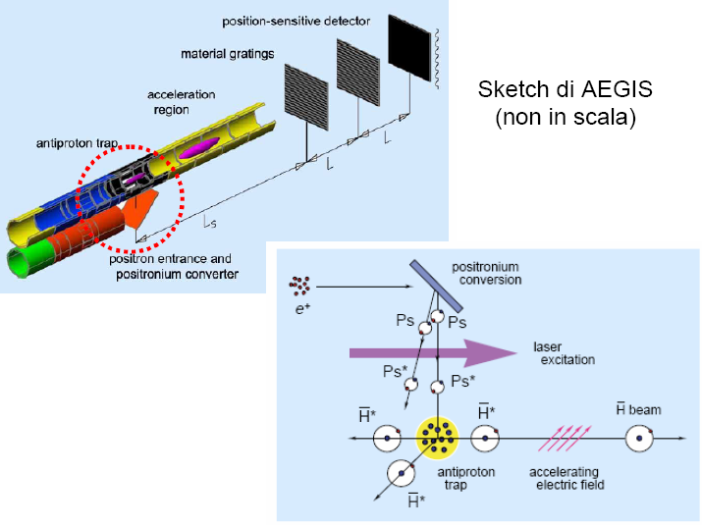

Positrons and Positronium (Ps) production
Technique: have a bunch of 10⁸ e⁺ in 20 ns
Have them impinge at ~keV energy on a (likely porous Silica) target
Vacuum
Solid
Positron beam
Ps
Orto-Ps produced in the bulk and “thermalized” by collision on pore walls
Ps
Ps used for the reaction:
Ps
Ps
Positronium emission

Slide 56
The charge-exchange reaction:
Conceptually similar to a charge exchange technique based on Rydberg cesium performed by ATRAP - C. Storry et al., Phys. Rev. Lett. 93 (2004) 263401
The cross-section is strongly dependent on the principal quantum number:
Laser excitation to Rydberg states of the Positronium atom is needed
The travel distance in 20 ns (pulse duration) is only 2 mm.
With a production of 10⁷ oPs atoms per pulse (20 ns -10⁸ e+)
a density of 10¹⁵ Ps/m³ is expected

Slide 57
Antihydrogen fall and detection
AEgIS realistic numbers:
- horizontal flight path L ~ 1 m
- horizontal velocity vz ~ 500 m/s
vertical deflection ~ 20 μm
BUT: - antihydrogen has a radial velocity (related to the temperature)
- any anti-atom falls by 20 μm, but, in addition it can go up or down by few cm
- beam radial size after 1 m flight ~ several cm (poor beam collimation)
DISPLACEMENT DUE TO GRAVITY IS IMPOSSIBLE TO DETECT IN THIS WAY

Slide 58
Let us collimate!
Position sensitive detector
cm
100 μm slit
Now displacement easily detectable. At the price of a huge loss in acceptance
Acceptance can be increased by having several holes. In doing so new possible paths show up
L₁
L₂
Let us collimate!
cm
If L₁ = L₂ the new paths add up to the previous information on the 3rd plane

Slide 59
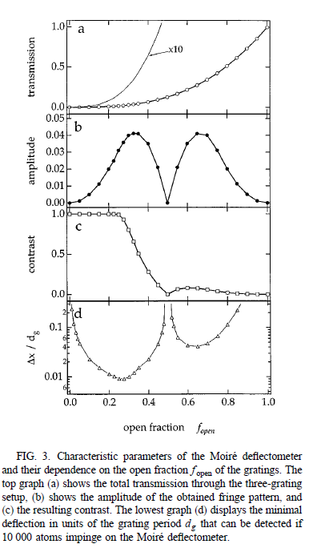
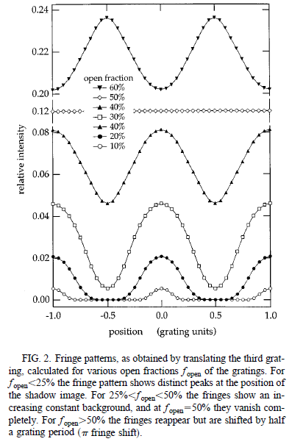
From M. K. Oberthaler et al., Phys. Rev. A 54 (1996) 3165

Slide 60
The final plane will be made of Silicon Strip detectors with a spatial resolution of about 10-15 μm
De Broglie wavelength of a 500 m/s H atom:
Now, this is NOT a quantum deflectometer, because:
d_{g}
α
L
So, it is a classical device if d_{g}>> 10 μm

Slide 61
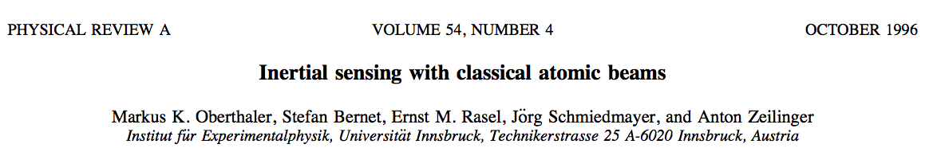

Collimation of the beam with a classical
M o i r é deflectometer
new position-sensitive detector
(to detect antihydrogen annihilation)
upgraded version

Slide 62
moiré deflectometer
M o i r é deflectometer
X
annihilation hit position on the final detector
(in x/a units)
Suppose:
- L = 40 cm
- grating period a = 80 μm
- grating size = 20 cm (2500 slits)
- no gravity
Z
Grating transparency = 30%
(total transmission 9%)
annihilation hit position on the final detector
(in x/a units, modulo grating period a)
fringes
-5 -4 -3 -2 -1 0 1 2 3 4 5
(x/a)
grating slits shadow
counts (a.u.)
slit
solid
slit
depends on the alignement between the gratings, and on the alignment between them and the center of the antihydrogen cloud. It is indepentend to the radial antihydrogen velocity and profile
]a
Δo (calculated experimentally)
0 0.25 0.5 0.75 1
x/a
counts (a.u.)

Slide 63
moiré deflectometer
M o i r é deflectometer
X
Suppose:
- L = 40 cm
- grating period a = 80 μm
- grating size = 20 cm (2500 slits)
- gravity
annihilation hit position on the final detector
(in a units)
beam horizontal velocity
Z
Grating transparency = 30%
(total transmission 9%)
vz = 600 m/s
vz = 250 m/s
annihilation hit position on the final detector
(in a units, modulo grating period a)
fringe shift
-5 -4 -3 -2 -1 0 1 2 3 4 5
(x/a)
grating slits shadow
counts (a.u.)
slit
solid
slit
]a
Fringe shift !
0 0.25 0.5 0.75 1
x/a
counts (a.u.)

Slide 64
Conclusions
AEGIS to develop a new “staged approach” to antimatter studies
Produce a beam of cold Antihydrogen starting from ultracold protons
Stark-effect accelerate Antihydrogen atoms
Let the beam fall in a Moire’ deflectometer
Measure the fringe shift and the arrival times on the final detector
Goal: 1% precision in the measurement of g for Antihydrogen
Experiment approved at CERN
…and by various funding agencies
Installation in experimental Hall began in 2011
Physics to begin in 2012

